Slide 1


Slide 2






Business project
Click Creators
Tiba Store
Omar Abdelhady
Elsayed Hassan
Mahmoud Atef
Ahmed Reda

Slide 3




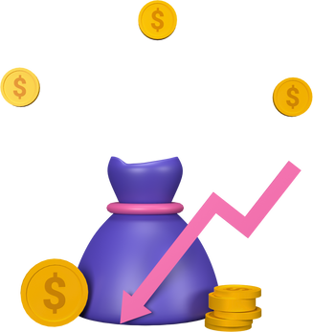
Project idea
Tiba Store is an Egyptian store offering a diverse range of high-quality beauty, cleaning, and baby care products at affordable prices.
Located in Banha, the store serves customers through both its physical store and online shop, providing a convenient and efficient shopping experience.
What sets Tiba Store apart is its reliance on a local digital experience, enabling same-day delivery within Banha, with direct communication via social media and WhatsApp.
The store also offers helpful educational content on home care, beauty, and childcare, adding real value to its customers beyond the purchase itself.
Tiba Store – The best for your family every day.

Slide 4


Vision & Business Goals
Vision
Tiba Store aims to be the premier destination for residents of Banha for high-quality home care, beauty, and baby products, offering a convenient shopping experience.
Tiba Store focuses on providing a seamless local digital experience that combines online shopping with direct customer service via social media and a dedicated Banha WhatsApp group, ensuring safe and reliable products at affordable prices and delivered on time.

Slide 5
Vision & Business Goals
Business Goals
Increase brand awareness in Banha: Enhance Tiba Store's presence across digital and social platforms to boost its reputation and build trust within the local community.
Attract and retain customers: Continuously engage with Banha residents through digital channels and offer them tailored deals and services.
Grow local sales: Achieve significant growth in demand and sales within the city by improving the shopping experience and providing fast delivery.
Build community loyalty: Foster a sense of belonging to Taiba Store as a trusted local brand that meets the needs of Banha families and adds real value to their lives.

Slide 6



Services Offered
Shopping via Social Media: Taiba Store allows customers to easily order their products through direct messages, including:
Beauty and skincare products (shampoos, creams, perfumes)
Household cleaning products (cleaners, sanitizers, air fresheners)
Baby care products (gentle shampoos, lotions, wet wipes)
Tiba Store focuses on providing a fast and reliable local shopping experience that combines quality and effective communication to best serve the residents of Banha.

Slide 7
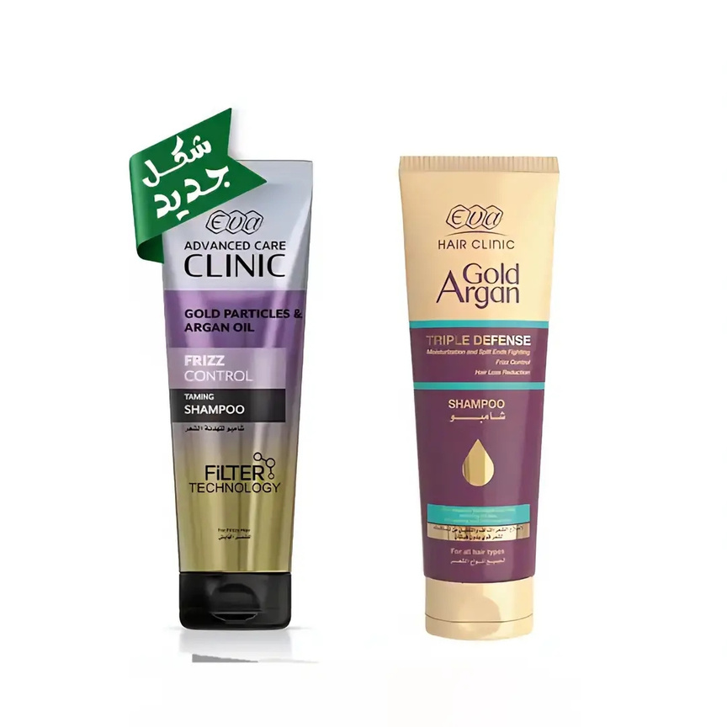
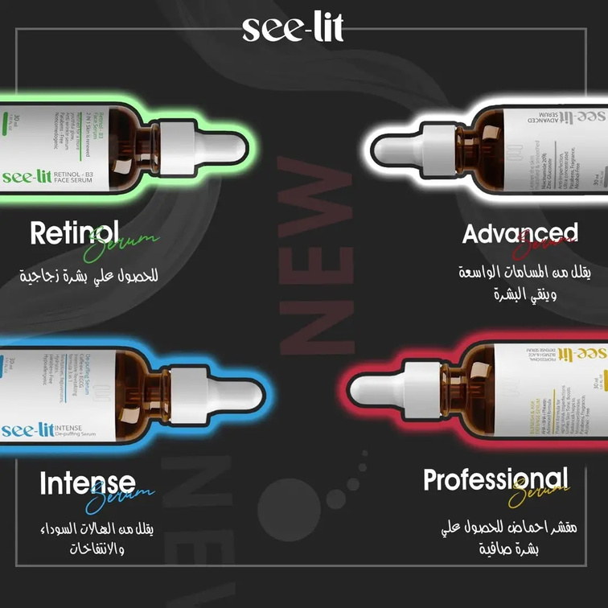
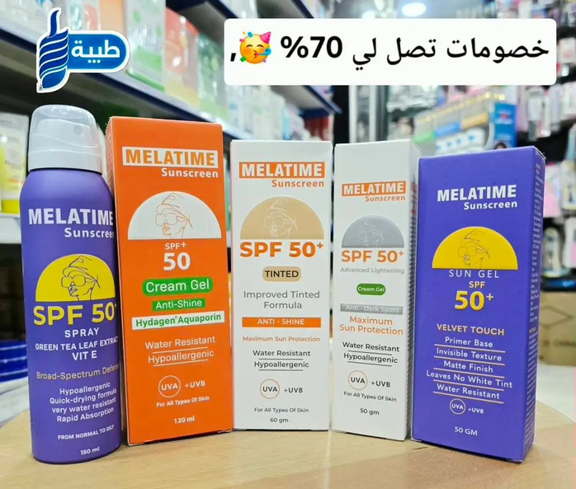


Product Gallery – Tiba Store
1) Beauty & Skincare Products

Slide 8
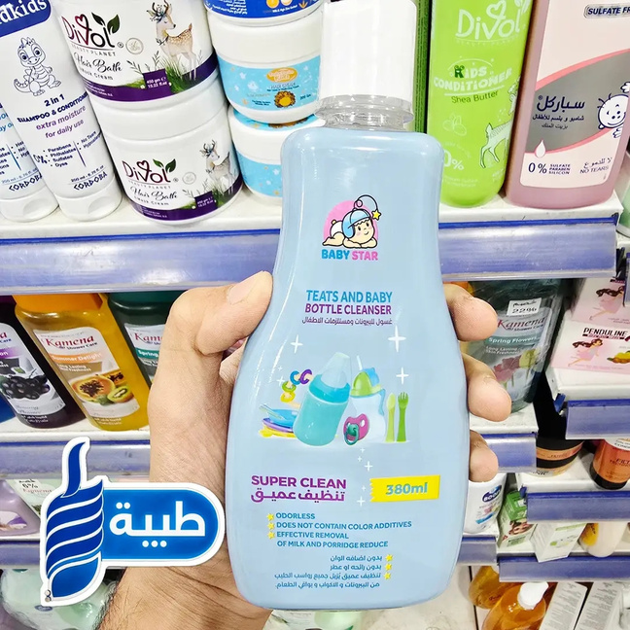
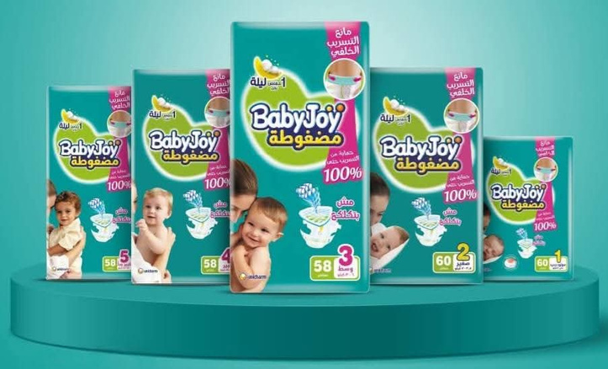
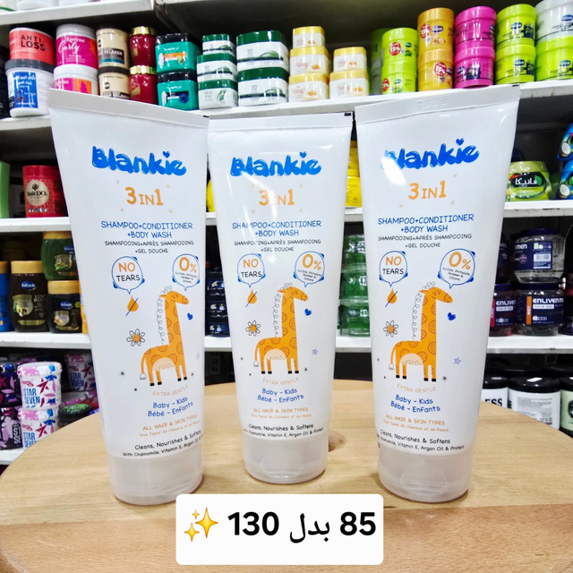
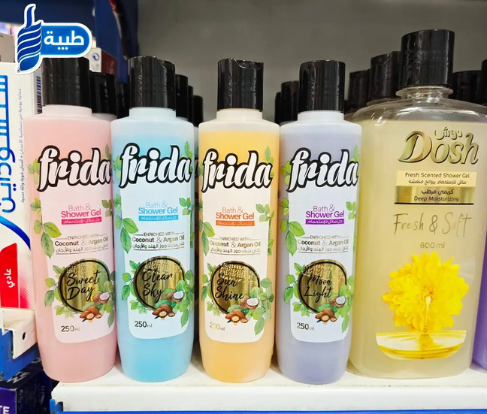
Product Gallery – Tiba Store
Baby Care Products

Slide 9

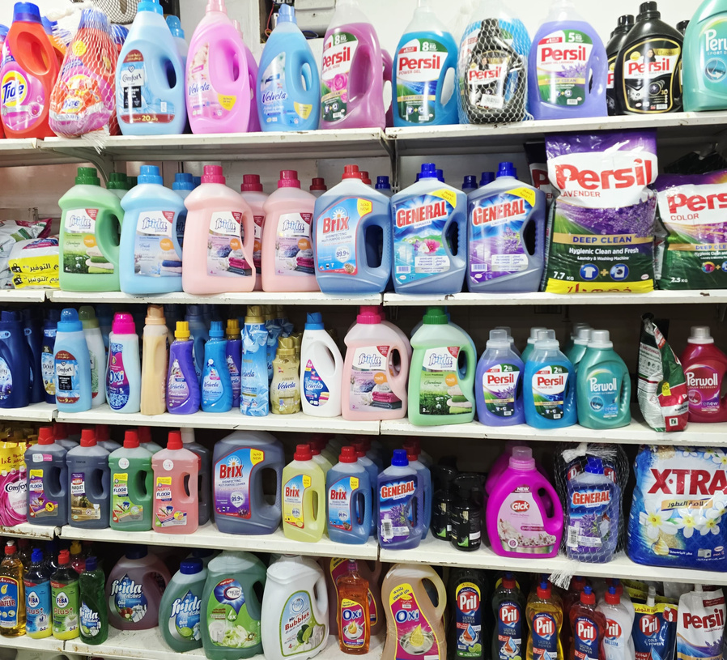
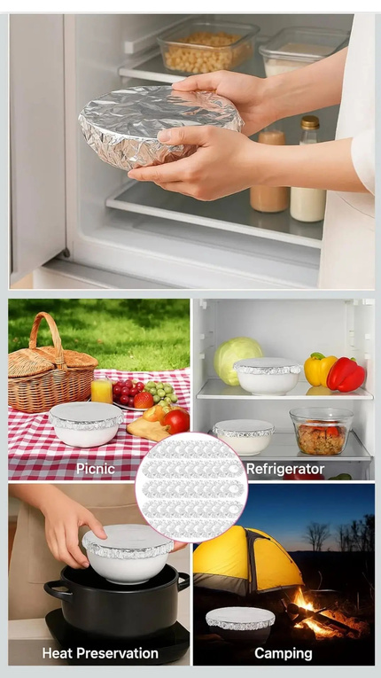
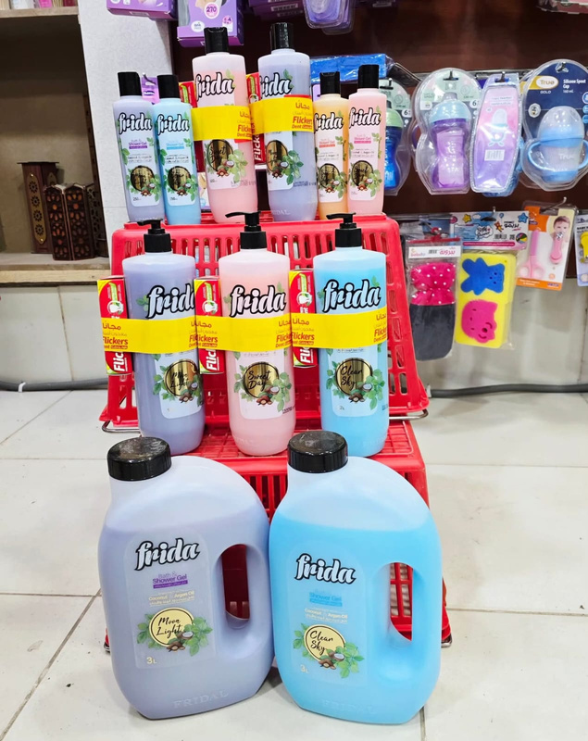
Product Gallery – Tiba Store
Home & Cleaning Products
"You can visit our Facebook page to explore all our products more clearly."
https://www.facebook.com/profile.php?id=61581922016882

Slide 10


Unique Selling Point (USP)
What truly sets Tiba Store apart is its focus on trusted local family needs. All products are carefully selected to ensure safety, quality, and everyday convenience for every member of the Banha family.
Unlike other stores that focus on a single product category, Tiba Store brings together beauty, baby care, and household cleaning products in one reliable location.
Tiba Store offers a personalized online shopping experience that feels just like being inside the store — with real-time support, product guidance, and instant assistance through WhatsApp and social platforms.

Slide 11
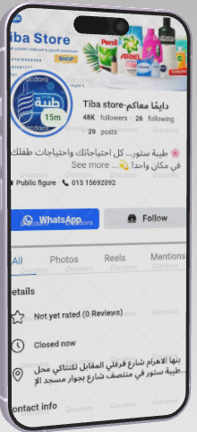
Marketing Channels Overview:
WhatsApp Business:
Used as a direct and personal communication channel, enabling customers to inquire about and order products easily and quickly.
Email Marketing:
A mailing list will be created to send exclusive offers and helpful content, aiming to enhance customer loyalty and encourage repeat purchases.

Slide 12
Marketing Channels Overview:
Social Media (Facebook, Instagram, TikTok):
These are the cornerstones of marketing campaigns, focusing on visual and interactive content such as Reels and short videos to showcase product usage and build an emotional connection with the audience.
Paid Advertising:
Through social media, we will reach potential customers based on their interests and digital behavior, ensuring increased awareness and sales within the local community.

Slide 13

DIGITAL MARKETING
PLAN

Slide 14
Situational Analysis
1.Overview
Tiba Store is a trusted local family shop based in Banha, providing a curated selection of beauty, cleaning, and baby care products.
The brand is built on three core values: quality, affordability, and convenience, with WhatsApp playing a central role in fast, personalized ordering and customer support.
By positioning itself as a “One-Stop Family Store,” Tiba Store has become a reliable choice for families seeking safe, everyday essentials.
2. Market Insights
Social media usage in Banha is extremely high, especially on Facebook, Instagram, and WhatsApp, creating strong opportunities for digital engagement.
Short-form video content—especially Reels and TikTok-style clips—drives the highest interaction among local audiences.
Families prefer buying from trusted local sources rather than unfamiliar online sellers.
WhatsApp remains the most efficient and trusted channel for inquiries, product recommendations, and order placement.

Slide 15
3. Audience Analysis
Primary Audience:
Women aged 20–45, especially mothers responsible for home, cleaning, and baby-related purchases.
Behavior & Preferences:
Highly responsive to short, clear video demonstrations
Trust brands that offer transparency and personalized communication
Prefer family-friendly brands that provide product education and practical tips
Strong interest in special offers, bundles, and value-focused deals
Rely on quick WhatsApp replies before making a purchase decision4. Competitor Analysis (Local Landscape)

Slide 16
3. Audience Analysis
Direct Competition:
Local shops and Facebook pages selling beauty and cleaning products, as well as mini-markets expanding into personal care items.
Market Gap:
Most competitors focus solely on low pricing, with limited attention to customer experience, product guidance, or branding.
Tiba Store differentiates itself by offering:
✔ Trusted and carefully selected products
✔ A warm, family-oriented brand identity
✔ Fast, personalized WhatsApp support
✔ Helpful educational content and practical tips
✔ A smoother digital shopping experience than typical local stores

Slide 17
4-Competitor Analysis: Finding the Market Gap
1. Market Landscape & Competitor Focus
Most competitors rely heavily on low pricing and basic product posting, creating a noisy and price-driven market.
Market Gap: No trusted local digital store offering an Integrated Family Solution (3Cs) with guaranteed product authenticity and quality.
Local competitors have stronger visibility inside the physical Banha market, which increases the challenge.
2. Tiba Store's Differentiation Strategy (USP)
Shifting the focus from “cheapest price” to Value, Quality, and Convenience.
One-Stop Family Shop Model: Cosmetics + Cleaning + Baby Care → saves mothers significant time and effort.
Strong local digital presence with fast, personalized WhatsApp Business support that drives immediate conversions.

Slide 18
4-Competitor Analysis: Finding the Market Gap
Actionable Insights & Learnings
Successful competitors grow trust through:
• Authentic User-Generated Content (UGC)
• Simple loyalty contests and customer participation
Tiba Store Action Plan:
• Prioritize real testimonials and micro-influencer collaborations to build trust quickly.
• KPI: Increase testimonial video views by 50%

Slide 19
WhatsApp is currently the strongest platform for conversions and building customer relationships.
Facebook provides the highest reach and access to Banha’s active community groups.
Reels and short videos consistently generate the highest engagement.
Key areas for improvement include:
– More consistent posting
– Introducing paid advertising
– Expanding collaboration with local micro-influencers
5. Digital Performance Audit

Slide 20

Internal Analysis (SWOT):
Strengths:
One-Stop Family Store: Tiba Store offers beauty, cleaning, and baby care products all in one place.
Strong Local Trust: High credibility among customers in Banha.
Fast & Personalized WhatsApp Support: Quick, reliable communication that feels like in-store service.
Existing Awareness: The brand already has recognition and is not starting from zero.
Established Customer Base: A solid group of returning customers.
Proven Social Media Sales: Consistent and strong sales through social platforms.
Weaknesses:
Low brand awareness outside of existing customers due to a heavy reliance on organic marketing.
Heavy dependence on organic content with limited paid campaigns.

Slide 21
Digital Marketing Plan
External Analysis:
Opportunities: The increasing activity of Banha residents on Facebook, Instagram, and TikTok presents strong opportunities for visual merchandising and direct engagement.
Growing emand for guaranteed, safe local products.
Threats: Growing competition from supermarkets and specialty online stores targeting the same demographics.
Customer price sensitivity due to market saturation

Slide 22

Objectives
•Sell: Increase sales by 20% within three months across digital channels.
•Serve: Improve customer satisfaction through faster response times and higher-quality service on WhatsApp and Telegram.
•Speak: Boost brand awareness and reach 10,000 new followers on Facebook and Instagram.
•Save: Reduce customer acquisition cost (CAC) by 15% through targeted campaigns.
•Sizzle: Build a strong brand image as the best and most trusted local store serving the families of Banha.

Slide 23
Strategy
Positioning: “The local store that understands the needs of Banha families and offers everything they need in one place.”
Value Proposition: Reliable quality, reasonable prices, and convenie and fast digital service.
Targeting: Focusing on families in Banha through the most active local social media platforms (Facebook, WhatsApp, Telegram).
Tone of Voice: Friendly, reliable, approachable, and emphasizing the family aspect.

Slide 24
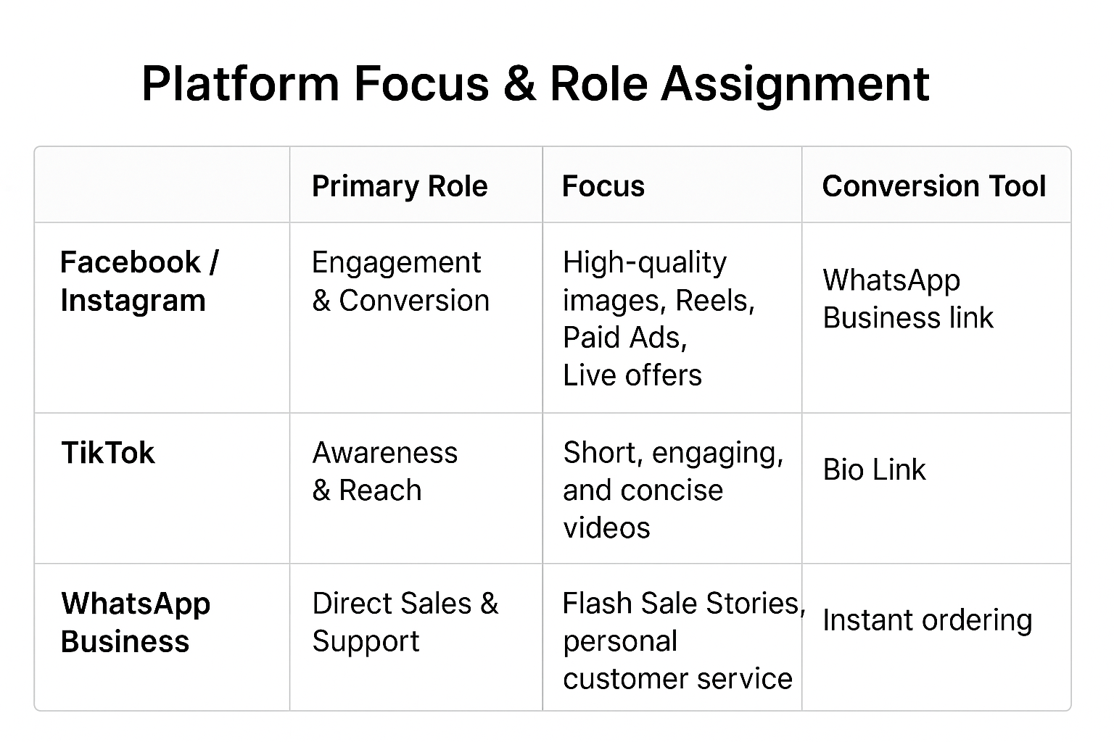

Slide 25
2. Content Pillars (The 3Cs Strategy)
​Content Hubs: The entire strategy revolves around the three core product categories (3Cs): Beauty, Cleaning, and Baby Care. ​
Consistency: The weekly content calendar ensures equal representation of all 3Cs to appeal to all segments of the target audience.
​3. Influencer & Engagement Plan
​Influencer Strategy: Collaborate monthly with 5-8 local Micro-Influencers from Banha to ensure authenticity and highly localized reach. ​
The TikTok Rule: Maintain an 80% Entertainment / 20% Marketing content ratio on TikTok to ensure high organic reach and participation.
​Goal: Drive authentic User-Generated Content (UGC) by featuring customer success stories and reviews weekly.

Slide 26



Tactics
Channel-Specific Tactics
These are the core, measurable activities supporting the strategy.
Facebook & Instagram – Ad Creative Rotation:
Rotate 5 unique ad creatives weekly
Continuously test CPC and CTR
TikTok & Reels – Viral Content Push:
Publish 3 trending videos weekly
Follow 80% Entertainment / 20% Marketing rule.
WhatsApp – Daily Conversion:
Daily exclusive offers, e.g., “WhatsApp Wednesday”
Drive high-urgency conversions
Bundle Strategy:
Promote integrated bundles (3Cs)
Increase Average Order Value (AOV) by 20%.

Slide 27
Actions
Action: Execution & Testing
​These are the operational steps required for optimization and control.
​Audience A/B Testing:
​Compare Mothers vs. Young Adults to optimize targeting.
​Conduct continuous split testing to reduce CAC (Customer Acquisition Cost).
​Influencer Tracking:
​Use unique direct links and discount codes per influencer.
​Ensure accurate conversion tracking and attribution.
​Customer Service SLA:
​Handle 80% of inquiries within 1 hour.
​Maximize fast conversion opportunities.
​Performance Control:
​Monitor ROAS (Return on Ad Spend) daily.
​Adjust weekly content if Engagement Rate (ER) drops below 5%

Slide 28
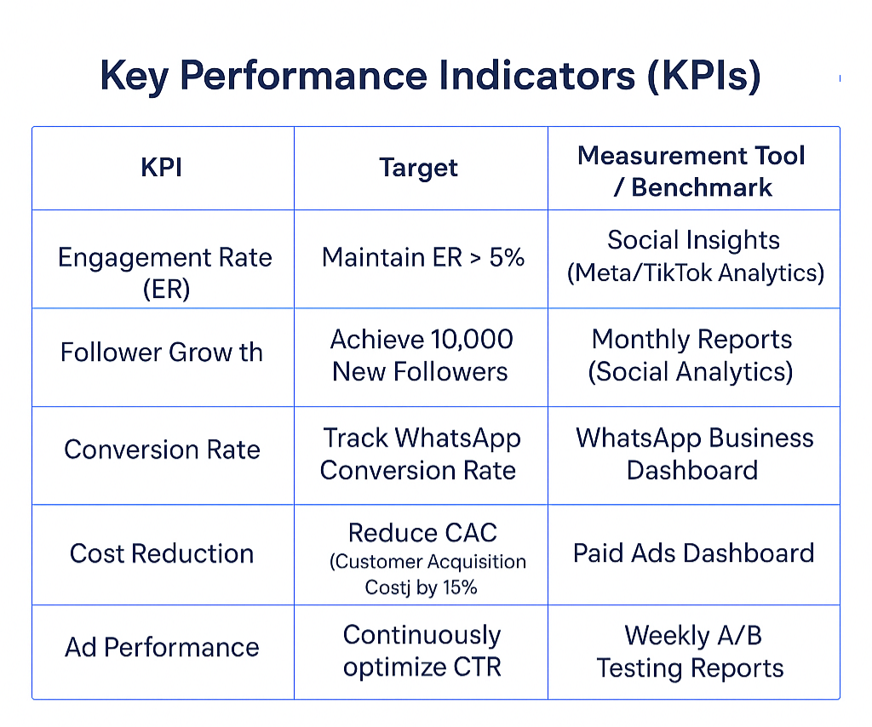

Slide 29
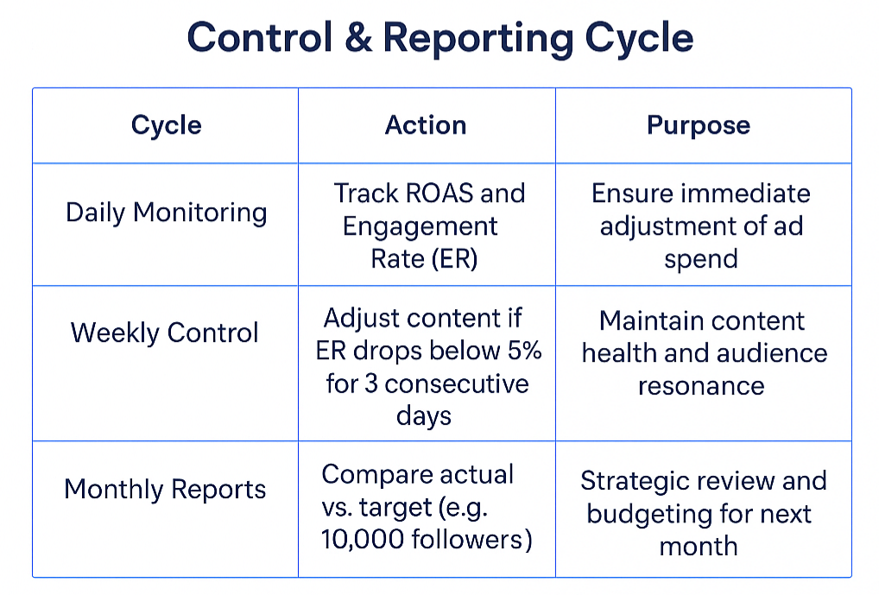

Slide 30
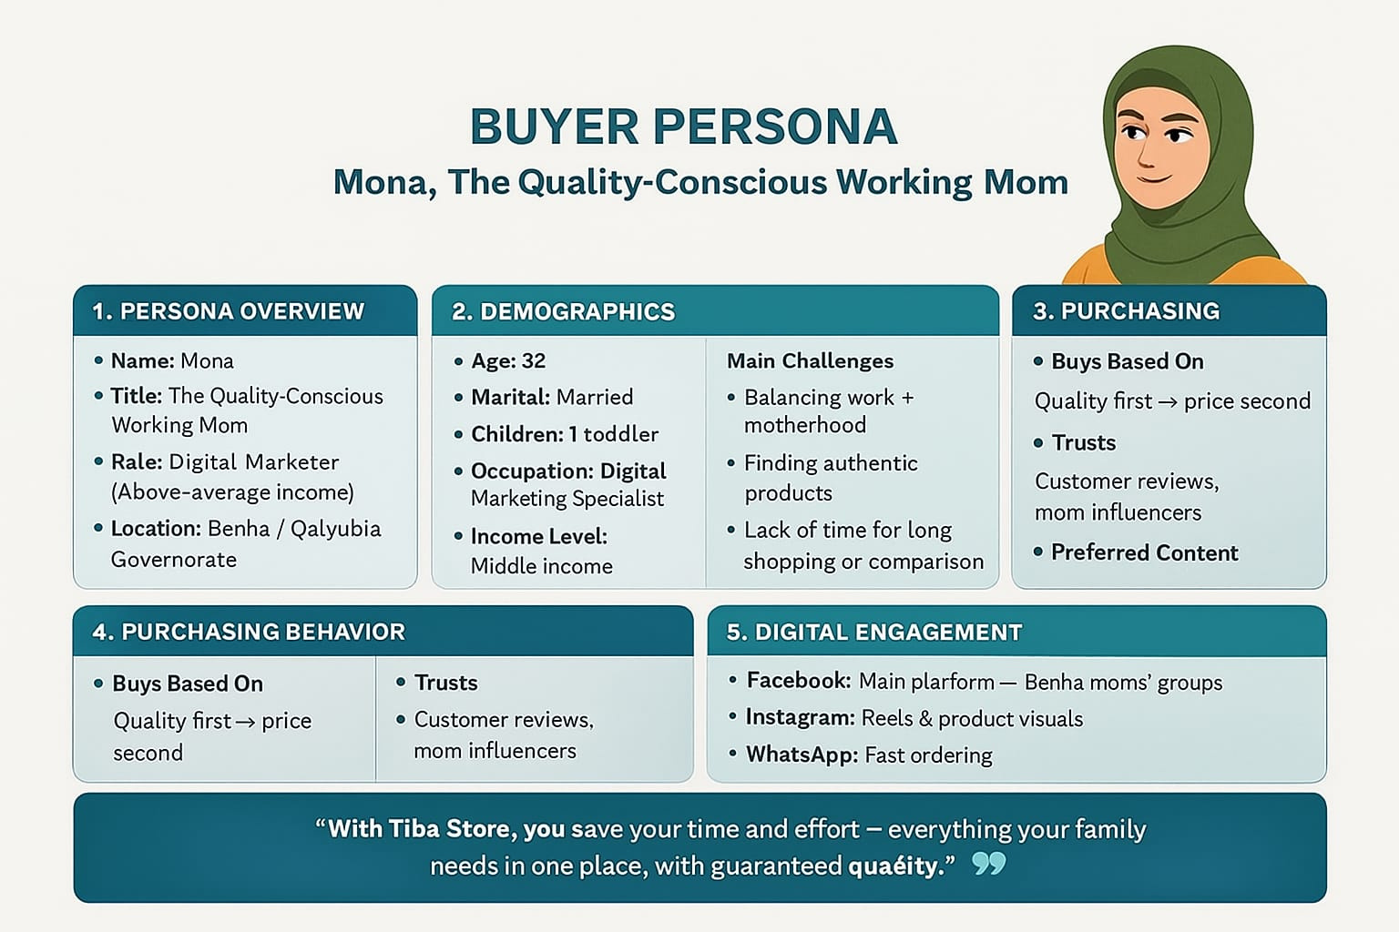

Slide 31
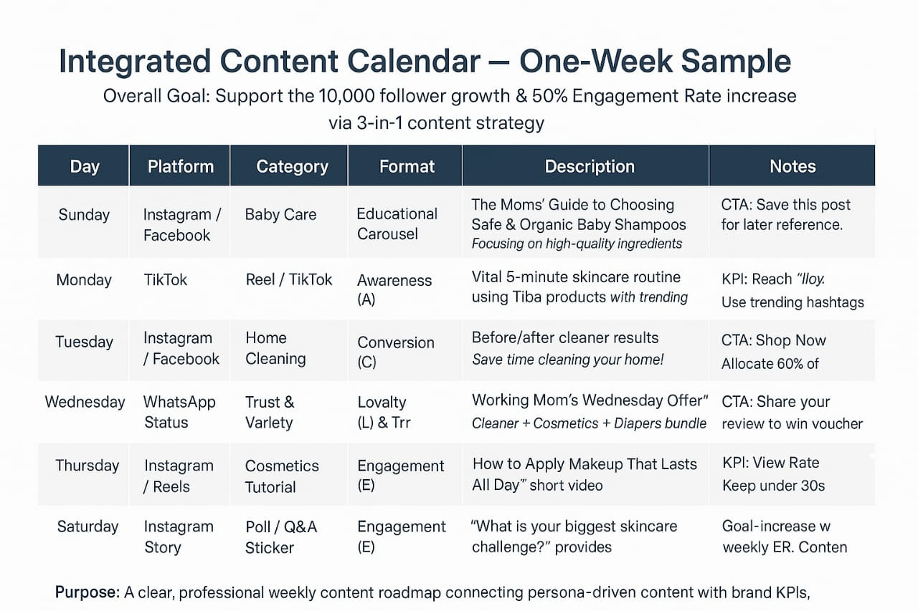

Slide 32
Enhancement Strategies (Future Growth)
1. CRM & Email Marketing (Scaling Loyalty)
​This strategy focuses on transitioning WhatsApp customers to a formal email database for long-term retention and cost-effective communication.
•​ List Segmentation: Divide the subscriber list into three dedicated segments based on purchase history: Cleaning, Beauty, and Baby Care.
•Welcome Series Automation: Implement a 3-step Welcome Series for new subscribers, concluding with a 10% discount code to drive the first purchase and build loyalty.
​• Personalized Offers: Send weekly targeted offers based on customer segmentation (e.g., Baby Care offers only to the Baby segment).

Slide 33
Enhancement Strategies (Future Growth)
2. Advanced Media Strategy (Optimizing ROI)
​This strategy introduces dynamic budget allocation to maximize return on ad spend (ROAS) and minimize waste.
​• Dynamic Budget Allocation: Implement a rule to dynamically shift 10% of the daily budget to the best-performing channel or ad set (highest ROAS).
• Funnel Expansion: Introduce specific campaigns targeting the Middle-of-Funnel (MOF) with content focused on product comparison and value proof to accelerate consideration.
• ​Retargeting Strategy: Create lookalike audiences from the highest-value WhatsApp customers to find similar high-potential users in Banha.

Slide 34
Summary & Budget Recommendations
1. Project Summary
​•Core Strategy: Shifting positioning from "price focus" to Value, Quality, and Local Convenience (One-Stop Shop).
•Key Action: Aggressive daily content push on TikTok/Reels (80/20 Rule) combined with optimized paid ads (A/B testing 5 creatives weekly).
​•Success Metric: Achieving a consistent Engagement Rate (ER) > 5% while reducing the CAC (Customer Acquisition Cost) by 15%.

Slide 35
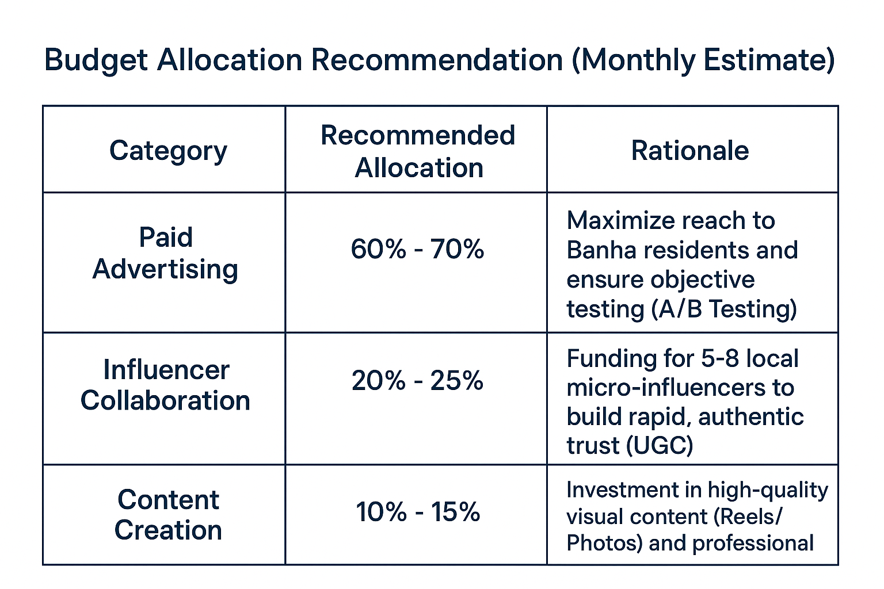
Summary & Budget Recommendations
2-

Slide 36
Summary & Budget Recommendations
3. The Ask (Call to Approval)
​We recommend obtaining immediate approval to initiate the core SOSTAC implementation phase, allowing us to leverage the existing budget and resources to establish Tiba Store as the premier local digital family shop in Banha.

Slide 37
Tiba Store: The Premier Local Digital Family Shop
​Summary of Our Commitment:
Focus: Transitioning Tiba Store from a local shop to the premier local digital destination in Banha. ​
Execution: A comprehensive SOSTAC plan focused on measurable growth, driven by dynamic content and optimized media spend.
​Goal: Achieving 10,000 new followers and reducing CAC by 15% in the first 3 months.
​“With your approval for this plan, we are ready to transform Tiba Store's digital future.”

Slide 38
Thank You & Q&A

